Slide 1
QUIC Latency Delay Bit & Q Bit Implementation and Analysis
Calculating RTT of QUIC connections

Slide 2
Background

Slide 3

QUIC
A transport layer network protocol – meant to replace TCP
Initially made by Google, now community based
Implements a TLS encryption as a part of the protocol
Each QUIC connection is identifiable by source and destination connection IDs
Encrypts not only data but most header fields as well.

Slide 4
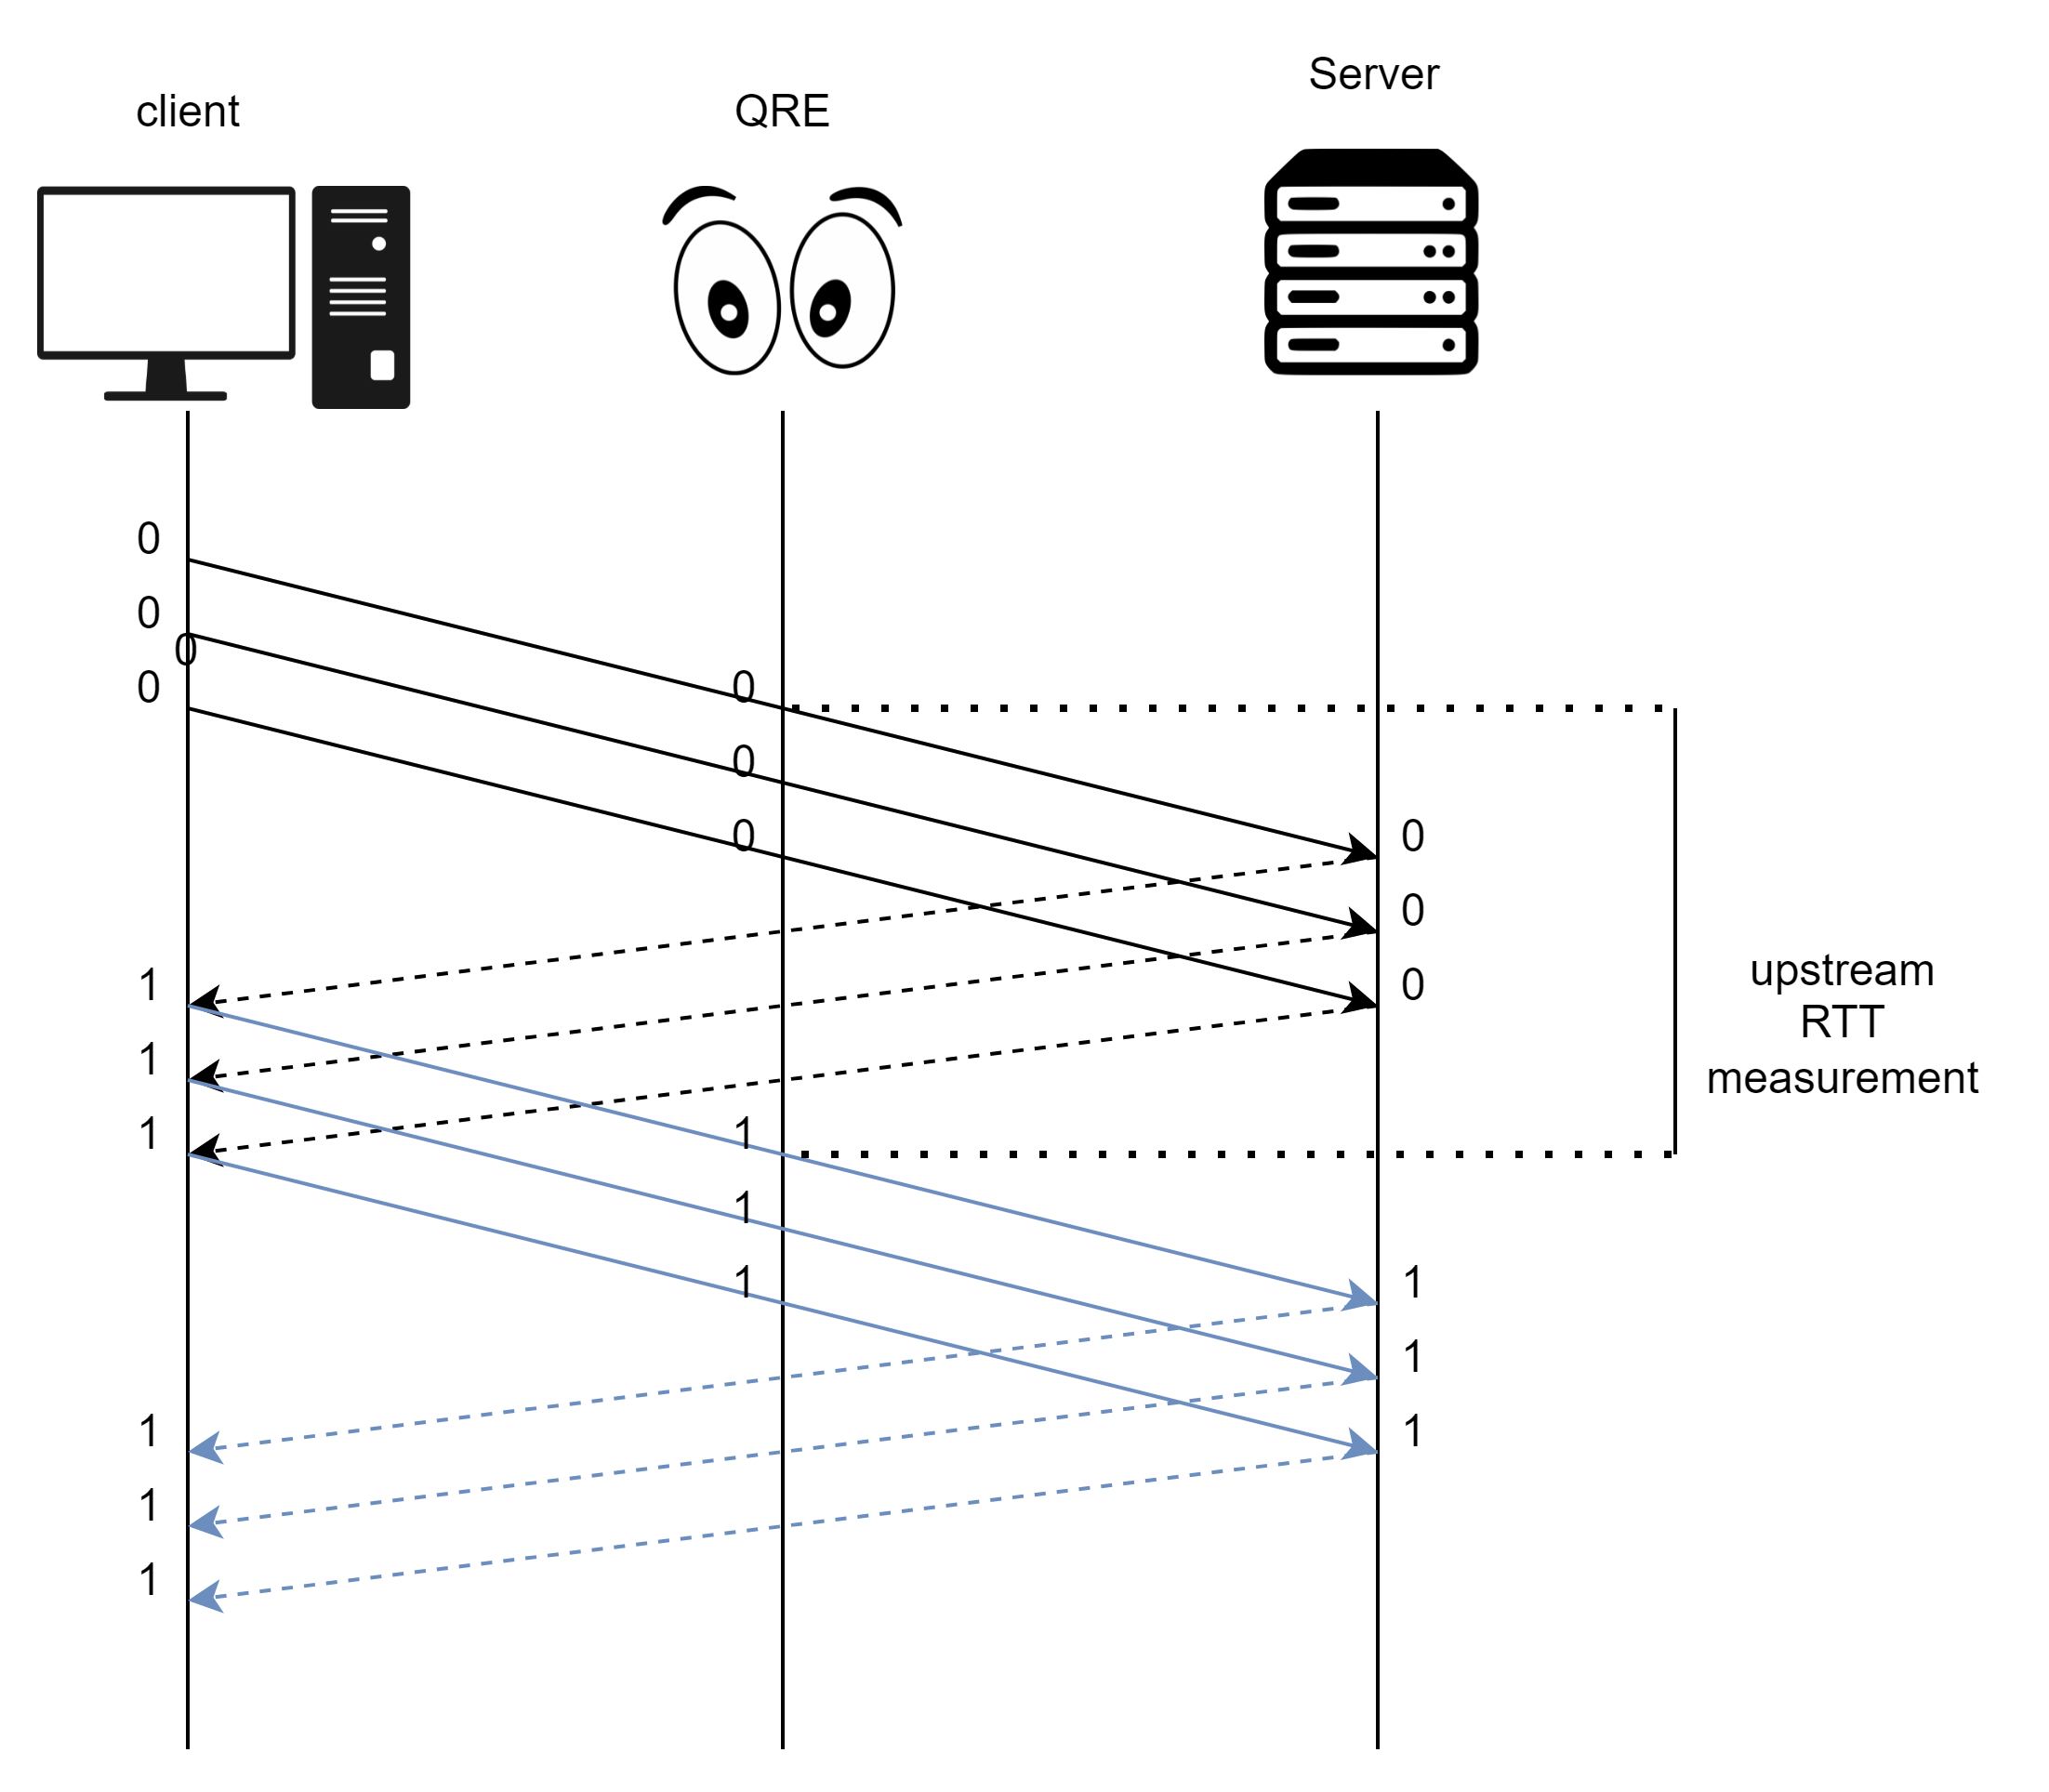
Latency Spin Bit
The spin-bit is a single-bit field in QUIC’s header
Its initial value is 0
Server only mirrors its value
Client changes its value once it gets a message with the same spin-bit value from the server.

Slide 5
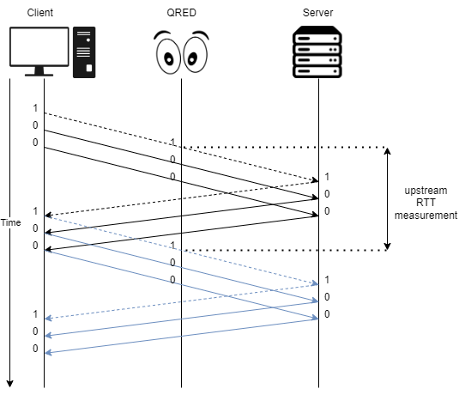
Latency Delay Bit
The delay is a single-bit field in QUIC’s header
Generation Phase: delay-bit is on (1) at client side for only one packet and switches to reflection phase.
Reflection phase: delay bit value is reflected from the last packet.
Server only mirrors its value
T_max: maximum time waiting for delay bit on. Client returns to generation phase

Slide 6
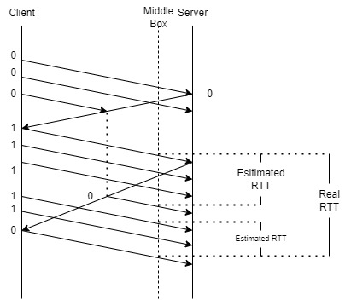
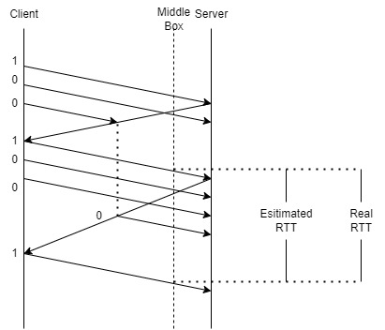
Edge Cases: Packet Reordering
SPIN BIT
DELAY BIT

Slide 7
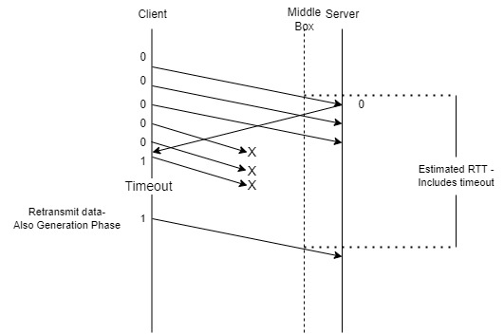
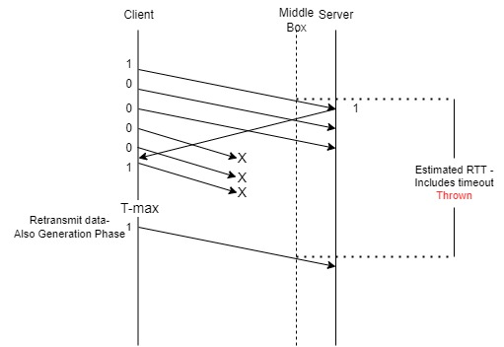
Edge Cases: Packet Loss
SPIN BIT
DELAY BIT

Slide 8
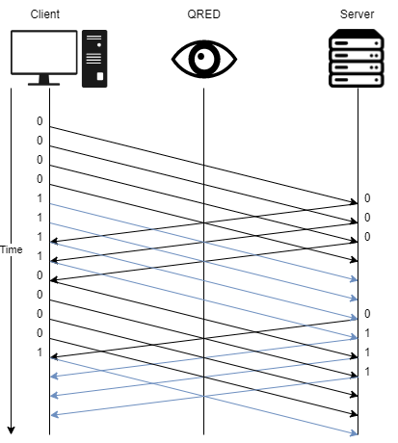
Q-Bit
The Q-bit is a single-bit field in QUIC’s header
Both the client and the server reverse the value of the Q-bit every N packets
A middle-box observer who knows N can see how many packets were dropped and measure the connection’s loss rate

Slide 9
NetEm
Packets wait in queues to be delivered by the hardware
Traffic Control is a set of tools (in linux) which manipulates said queues and packets before they are delivered by the hardware
NetEm (short for Network Emulator) is one of the Traffic Control’s tools

Slide 10
Our Project

Slide 11
Objectives
Implement the Latency Delay Bit and Q Bit mechanisms in aioquic’s implementation of the QUIC protocol
Create a “middle-box” observer that estimates RTT by the Delay Bit and packet loss by the Q Bit.
Setup a network to test the QUIC protocol on different challenges – delay, reordering, Sporadic loss and burst loss.
Perform measurements on said network with different scenarios and compare RTT results of the Latency Delay Bit and Latency Spin Bit in edge cases.
Perform measurements on the Q Bit accuracy in an environment of changing loss rates.

Slide 12
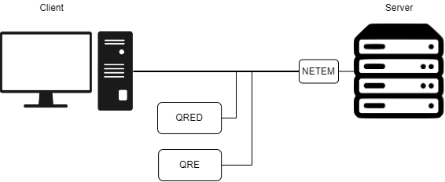
Objectives

Slide 13
Milestones
Research
Implement Delay Bit
Implement QRED
Delay bit, Q bit
In aioquic, alongside spin bit
QRED - QUIC RTT Estimator using Delay bit
Measure & Analyze
Modify QRED
Implement Q bit
To estimate loss rate as well
In same distribution

Slide 14
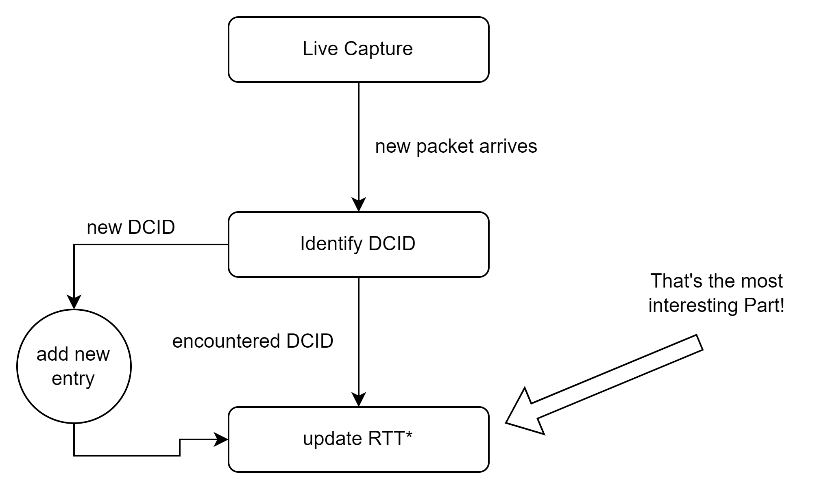
HOW IT WORKS

Slide 15

Live Demo

Slide 16
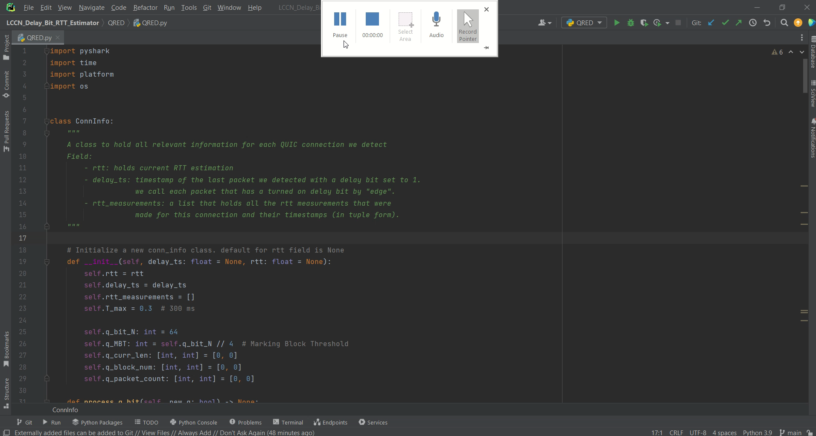

Slide 17
Results

Slide 18
No NetEm: Server to Client

Slide 19
No NetEm: Client to Server

Slide 20
10ms Delay: Server to Client

Slide 21
10ms Delay: Client to Server

Slide 22
Reorder 20ms 25% 50%: Server to Client

Slide 23
Reorder 20ms 25% 50%: Client to Server

Slide 24
10% Sporadic Loss: Server to Client

Slide 25
10% Sporadic Loss: Client to Server

Slide 26
25% Sporadic Loss: Server to Client

Slide 27
25% Sporadic Loss: Client to Server

Slide 28
5% 25% Burst Loss: Server to Client

Slide 29
5% 25% Burst Loss: Client to Server

Slide 30
Q Bit
Loss rate | Reorder Rate (Burst Rate) | Q Bit Estimation for Loss Rate | Deviation | Message Size
0% | 0% | 0.256% | +0.256% | 10MB
10% | 0% | 9.832% | -1.168% | 10MB
10% | 20ms 25% (50%) | 10.054% | +0.054% | 10MB
20% | 0% | 20.170% | +0.17% | 20MB
20% | 10ms 25% (50%) | 20.073% | +0.073% | 10MB
20% | 20ms 25% (50%) | 19.926% | -0.074% | 10MB
20% | 20ms 50% (0%) | 20.570% | +0.57% | 5MB
30% | 0% | 30.234% | +0.234% | 1MB
40% | 0% | 38.723% | -1.277% | 1MB

Slide 31
Conclusions: Spin vs. Delay
With no interruptions the Spin Bit and Delay Bit behave similarly (as expected)
With added delay: Delay Bit is more resistant to anomalies.
With high loss rate: the Spin Bit measures unexpectedly but the Delay Bit doesn’t produce enough measurements
With packet reordering the Delay Bit’s measurements are more reliable

Slide 32
Conclusions: Q Bit
In low to high loss rates, the Q Bit has good accuracy (±0.5% usually)
A high value for N might result in low connections not being analyzed
A low value for N combined with packet reordering might result in bad accuracy

Slide 33
Moving Forward…
Improving RTT measurement heuristic for both Spin Bit and Delay Bit
ignore anomalies
Deploy our scripts into an IOT device and analyze real connections
Implement and analyze the remaining suggested loss bits
Analyze loss rates more to depth
Since this is the most interesting case
Set a threshold of loss rate to switch from Delay Bit estimations to Spin Bit estimations

Slide 34
SUBMITTERS
Yogev Ron
Nadav Mordechai
SUPERVISOR
Eran Tavor

Slide 35
THANK YOU!

